Slide 1
Via.com
Project Gladiator Group-6 Set-3
By:-
1.Sappa Kondalarao -(10698771)
2.Shikhar Singh -(10698830)
3.Srihari V -(10699467)
4. Sunitha -(10698848)
5.Swapnil -(10698995)

Slide 2
Content
Introduction
Working System
Test Planning
Test Monitoring & Control
Test Case Analysis
Test Steps
Test Implementation
Selenium Script Writing
Website Results
Defects
Extent Reports
Problems Faced
Conclusion and Result
Work Repository

Slide 3
Introduction
About Via.com
Via.com is a Indian travel portal and online travel company on which we are testing for Booking Flights and hotels. To automate via wed application The domain of the booking is used and we are basically focus on the functionality of (a)Login, (b)Registration, (c)Search Flights and Book Flights, (d)Search Hotels and Book Hotels.
Scope
This project deals with covering the following scripts for testing of functionality of via.com
Preparation of Test cases and Test scenarios for all functionality
Preparation of test script for automation.
Preparation of HTML reports of the cases.

Slide 4
WORKING SYSTEM
Requirement Analysis
Test Planning
Test Case Development
Test Execution
Test Cycle Closure
Test extent report

Slide 5
TEST PLANNING
The testing starts with planning of all the positive and negative scenarios for the various functionality of the website.
All the possible cases are mapped in test cases with all the steps to be done is mentioned.
After creating all test cases, Manually test the cases on the website and getting the required result. Further comparing with expected results will give us the pass or failure of the cases.
Automating all the test cases in the selenium code and verifying the cases again for pass and failure.
Generating the HTML reports of all the cases with pass or failure of each function is mentioned.
Making the final report and closing the test.

Slide 6
Test Monitoring & Control
Tasks, Estimated Efforts And Target Dates Of Completion.
Task | Time Required | Target Completion Date
TESTING PROJECT (Via.com) | 5 days | 14/03/22 (Tuesday)
Test Planning and Designing | 1 day | 15/03/22 (Wednesday)
Test script writing | 2 days | 17/12/21 (Friday)
Test Execution | 1 day | 20/12/21 (Monday)
Report generation | 1 day | 20/12/21 (Monday)

Slide 7
TEST CASES ANALYSIS
Total number of test cases generated and executed.
FUNCTIONS | TOTAL TEST CASES | CASES EXECUTED
Login | 8 cases | 8 cases
Registration | 15 cases | 15 cases
Flight Search (one way, round trip and multi city) | 12 cases | 12 cases
Flight Bookings | 5 cases | 5 cases
Hotel Search | 5 cases | 5 cases
Hotel Bookings | 7 cases | 7 cases

Slide 8
TEST STEPS
FOR REGISTRATION
FOR LOGIN
1. User will first open the via website link
2. User will click on Sign In button on left.
3. User will click on sign up button
4. User will enter the email address
5. User will enter the password
6. User will enter the name
7. User will enter the repeat mobile number
8. User will click on create account.
1. User will open the application in browser
2.User will click on the Log in Button
3. User will enter the email in email box.
4. User will enter the password in password box.
5. User will click on Sign In button.

Slide 9
TEST STEPS
FOR FLIGHT SEARCH
FOR FLIGHT BOOKING
Click on Flights section
Click Round trip option
Enter From details
Enter To details
Click on departure date and select the date from calender.
Click on return date and select the date from calender
Enter number for persons travelling by selecting adult as 2 by using + sign.
Click on "show more options".
Select the class of journey.
Click on "search Flights".
Select the appropriate onward flight
Select the appropriate return flight
Click on the "BOOK FLIGHTS"
1. Open the Passenger details page by giving from, to, departure date, and 2 passengers on select for appropriate flight we direct to passengers page
2. Enter the title in adult 1 section
3. Enter the first name in section
3. Enter the last name in section
4. Select the day, month and year in date of birth
5. Click on show more options.
6. Select the meal from section
7.Select the baggage from the section.
8. Enter the mobile number in mobile section.
9. Enter the email in email section
10. Click on the refund note line.
11. Click on the terms and conditions line
12. Click on "proceed to payments" button

Slide 10
TEST STEPS
FOR HOTEL SEARCH
FOR HOTEL BOOKING
Click on Hotel section tab at the top.
Select Destination
Select Check-In tab and select the respective date.
Select Check-Out tab and select the respective date.
Click on rooms and guest and select the number of rooms and guests by + sign
Select Nationality
Select Residence
Click on search for Hotels
Select Hotel from the respective options.
Select room from the sub menu displayed.
1. Open the Guest details page by giving DESTINATION, CHECK IN, CHECK OUT, ROOM AND GUESTS, NATIONALITY AND RESIDENCE and search hotel and select the appropriate hotel to redirect to passengers page
2. Enter the title in adult 1 section
3. Enter the first name in section
3. Enter the last name in section
4. Enter the PAN Number
5. Click on SSR DropDown.
8. Enter the mobile number in mobile section.
9. Enter the email in email section
11. Click on the terms and conditions line
12. Click on "proceed to payments" button

Slide 11
TEST IMPLEMENTATION
REQUIREMENT TRACEABILITY MATRIX (RTM)
FUNCTIONS | TEST CASE ID
Login | LC_001 – LC_008
Registration | RC_001 – RC_015
Flight Search (one way, round trip and multi city) | ONE_001 – 0NE_004 RTP_001 – RTP_006
Flight Bookings | TC_001 – TC_005
Hotel Search | HS_001 – HS_005
Hotel Bookings | HB_001 – HB_007

Slide 12
Selenium Script Writing
The selenium codes were written and executed on the Eclipse API.
All the required jars are added with the help of MAVEN project in which the dependencies were added in the POM.xml file.
Properties file was used for the common variables in the program and the file was accessed with the help of file input stream.
The codes were written in Page Object Model framework where a separate POM class was created, and all the methods were defined under that only. The methods are accessed in codes by declaring the object of the POM class and methods were called with parameters.
The reports were created using Third Party API which is Extent report and dependencies were added to use the jar files in code.
The codes were written in testNG using @BeforeMethod, @AfterMethod and @Test with @DataProviders.

Slide 13
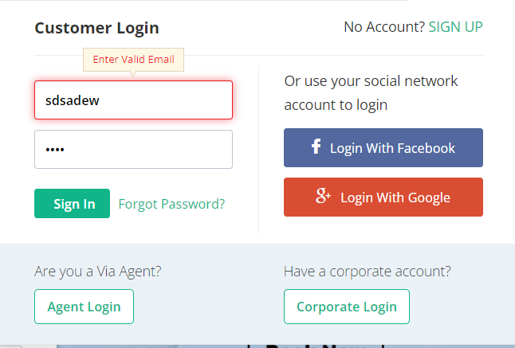
Website Results
Message when invalid login is done.

Slide 14
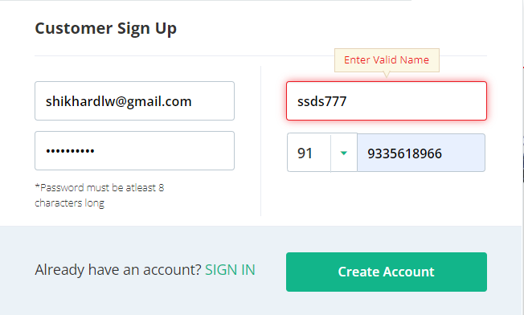
Website Results
Message when invalid signup is done.

Slide 15
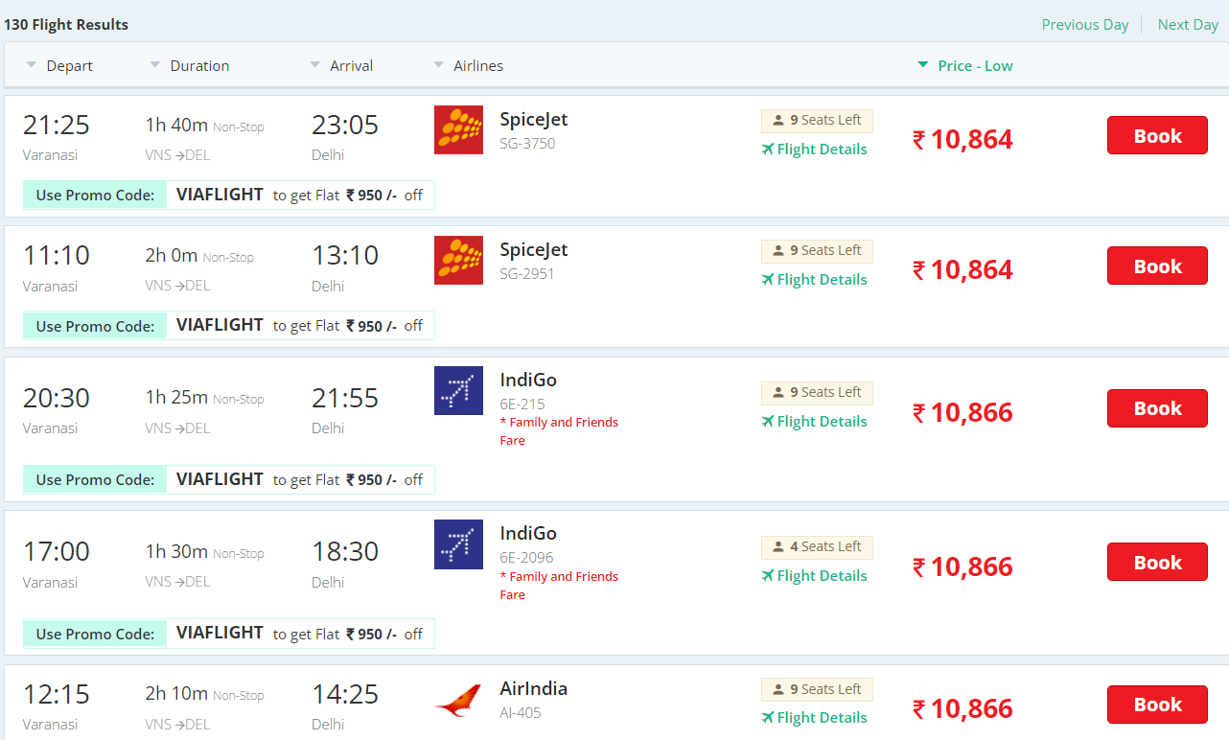
Website Results
Search results in case of successful one-way search.

Slide 16
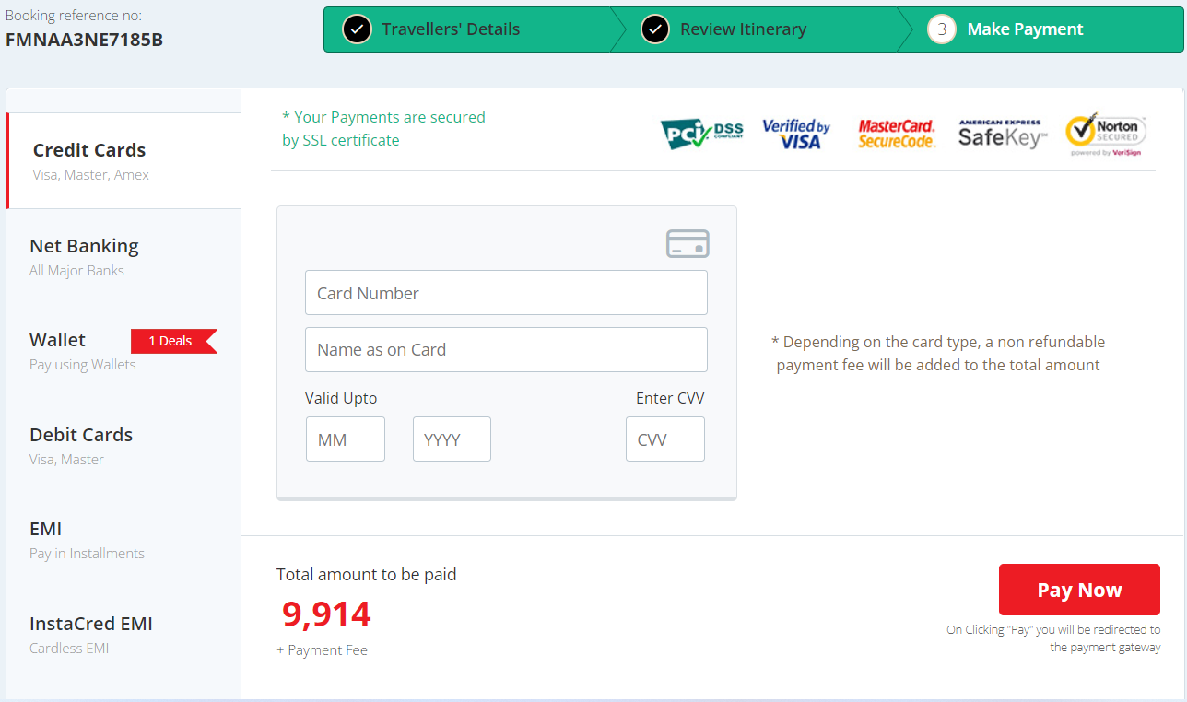
Website results
Website results on successful payments page in flight and hotel booking.

Slide 17
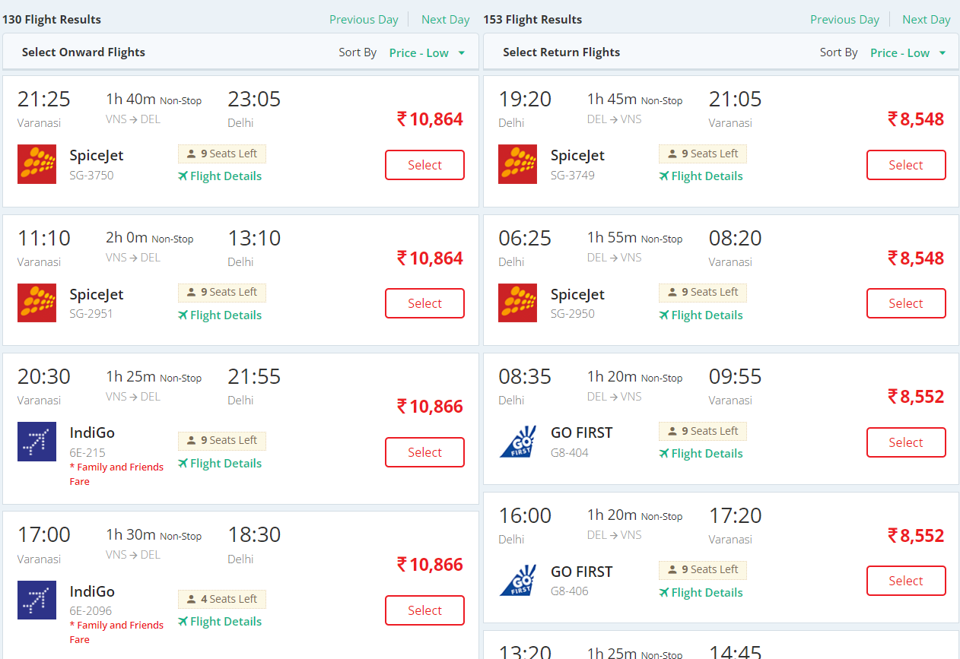
Website Results
Search results in case of Round-trip and Multi-city search

Slide 18
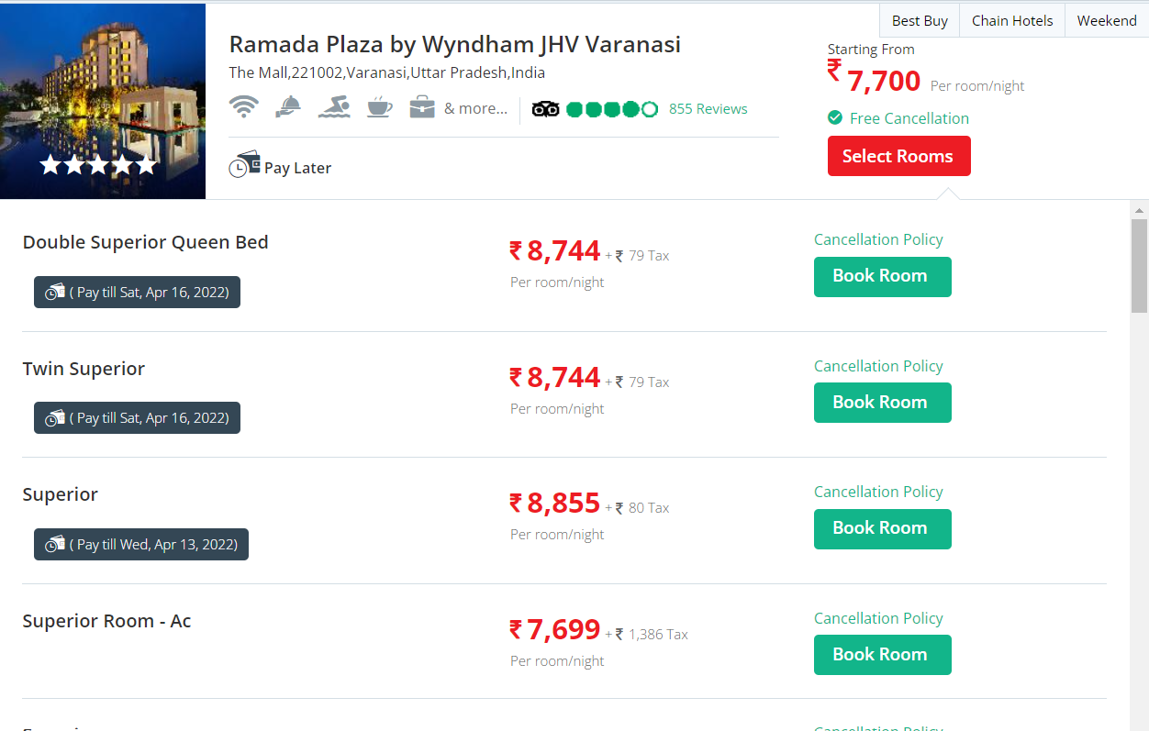
Website Results
Search Results in case of hotel booking

Slide 19
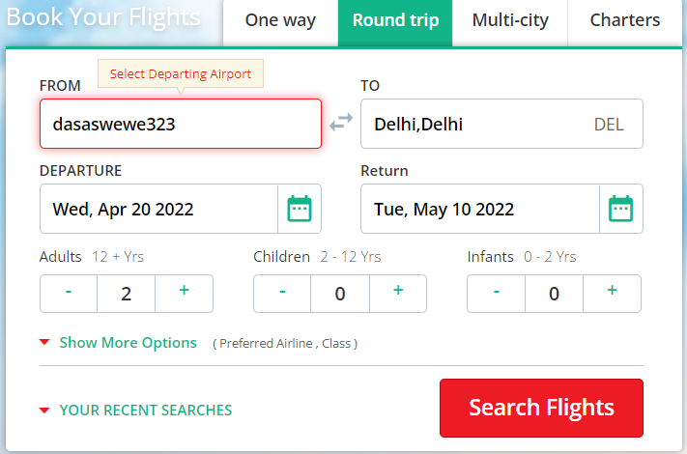
Website Results
Website message in case of wrong credentials in flight search

Slide 20
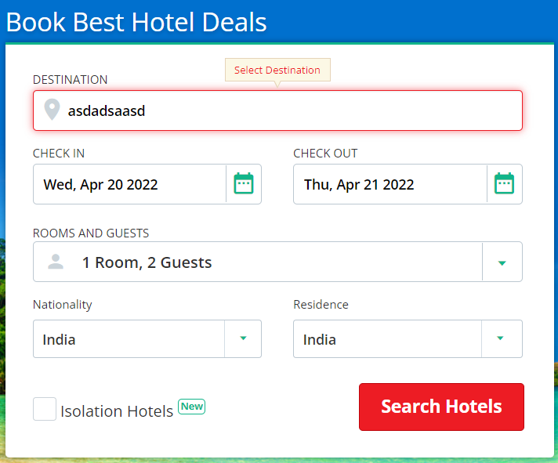
Website Results
Search message in wrong details of hotel booking

Slide 21
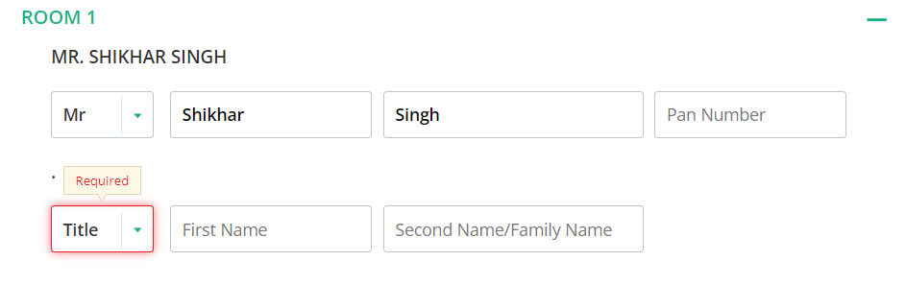
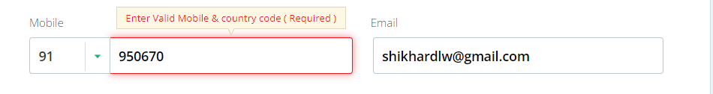
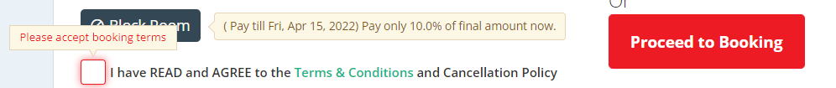
Website Results
Blank credentials in name tab
Invalid inputs in mobile number tab
Unchecked terms and conditions box

Slide 22
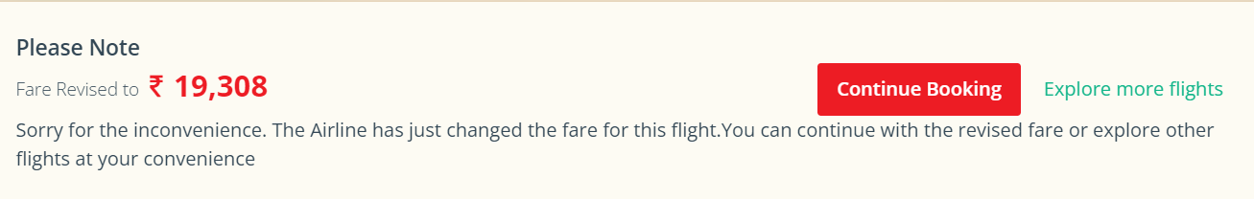
Website Results
Book Flight tab appearing after selection of flight
Fare rise popup box in traveler's details

Slide 23
DEFECTS
As the website is working completely fine for all cases but error found at some places during the following testing:
Sometimes the flight search often responds incorrectly. The flight sequence suddenly gets changed after some seconds .
Some of the hotel servers taking too much time to respond and not displaying the information.
At some hotels in hotel search, the rooms are showing sold out for every type of room. This maybe the site is not updated of details.
Sometimes the Login is not performed for correct credentials.

Slide 24
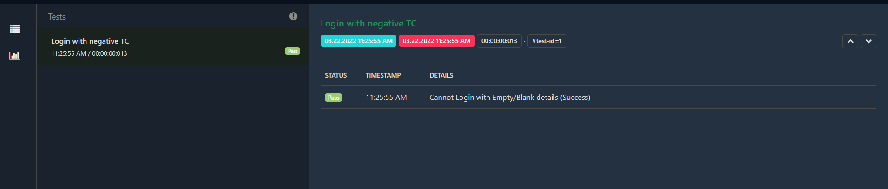
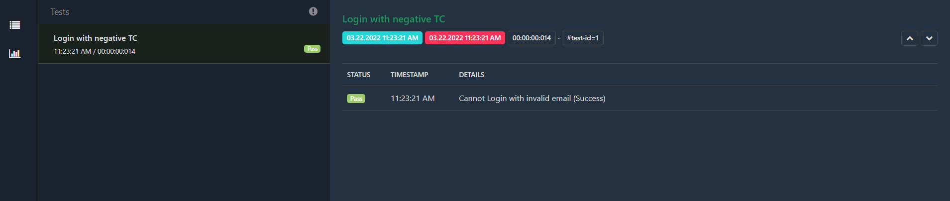
Reports-Login

Slide 25
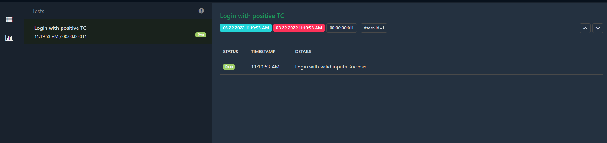
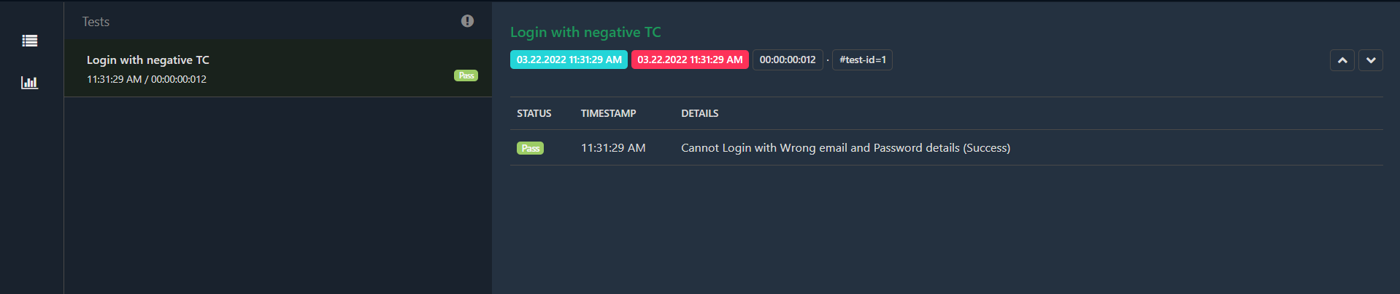
Reports-Login

Slide 26
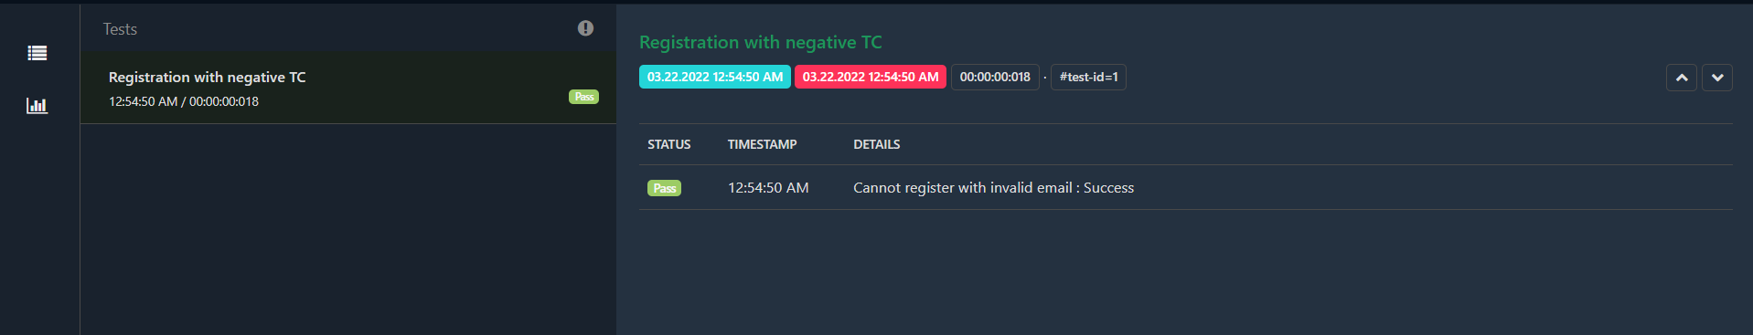

Reports - registration

Slide 27
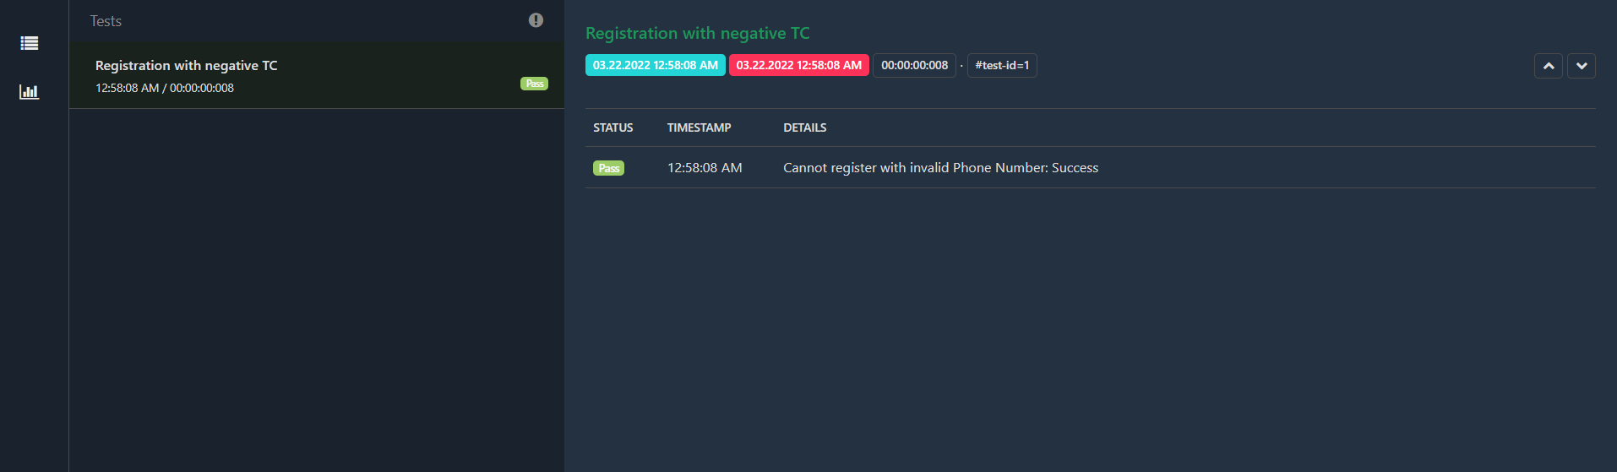
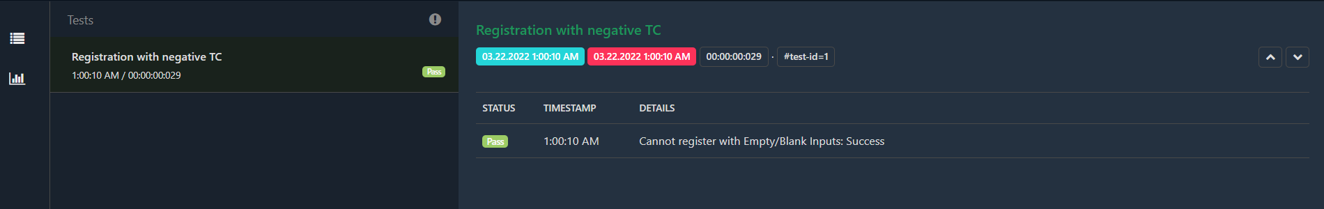
Reports - registration

Slide 28
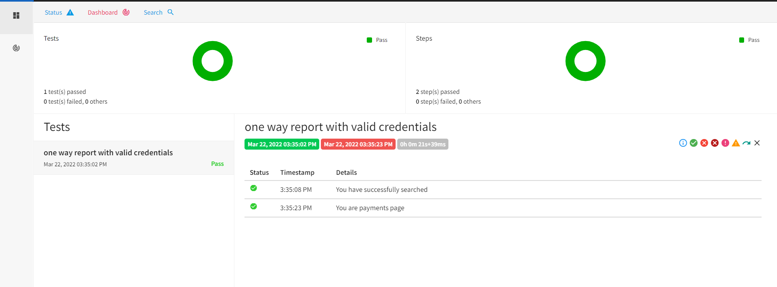
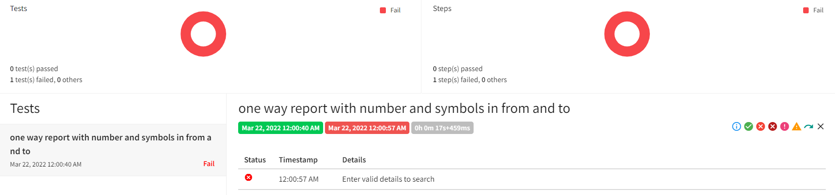
Reports – One Way Flight Booking

Slide 29
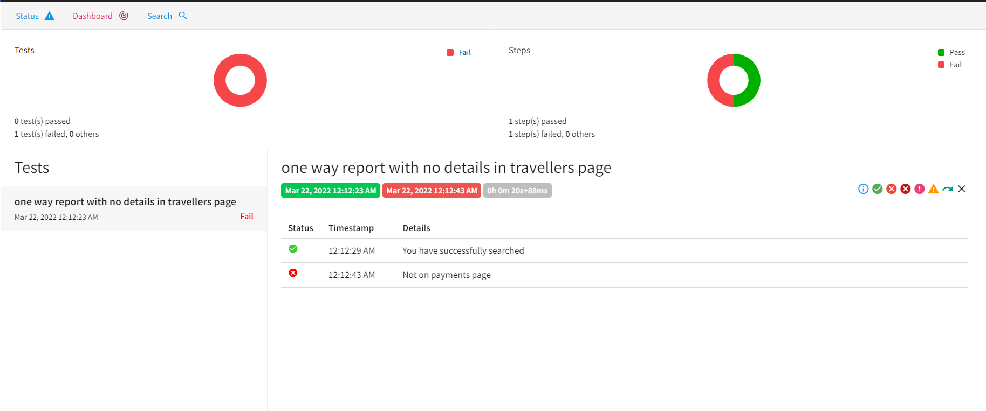
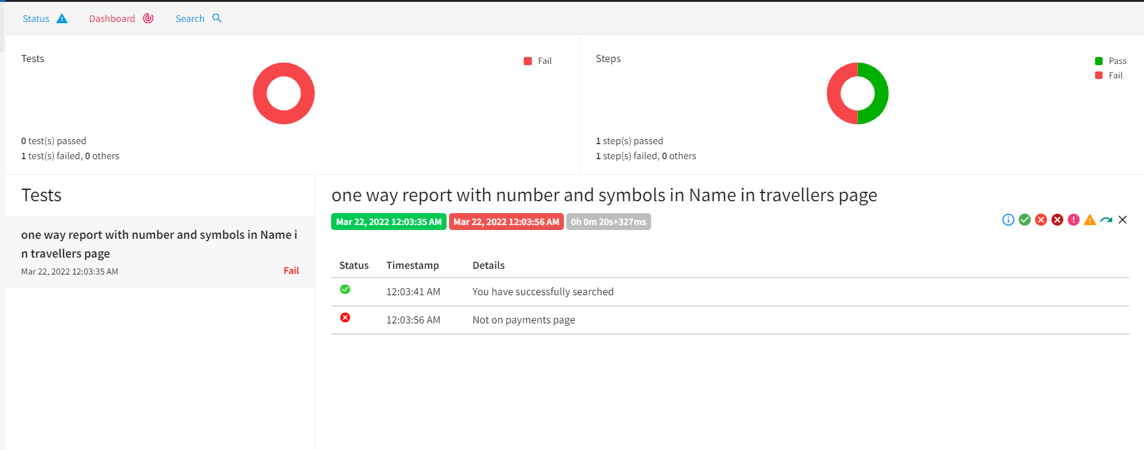
Reports – One Way Flight Booking

Slide 30
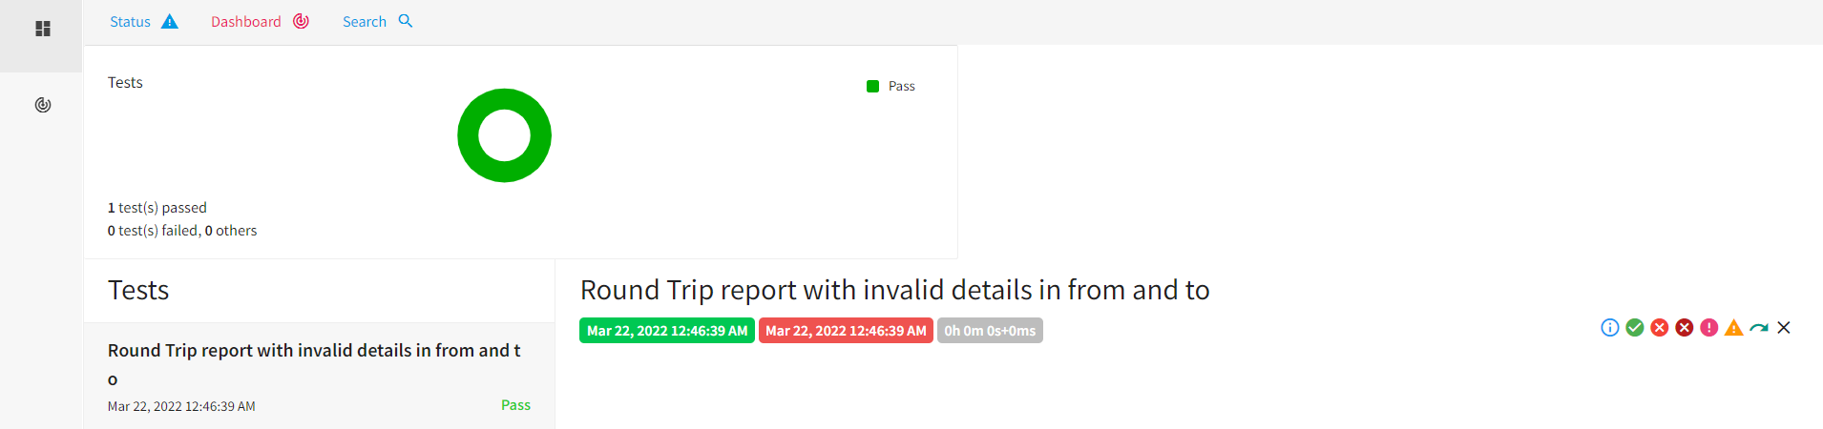
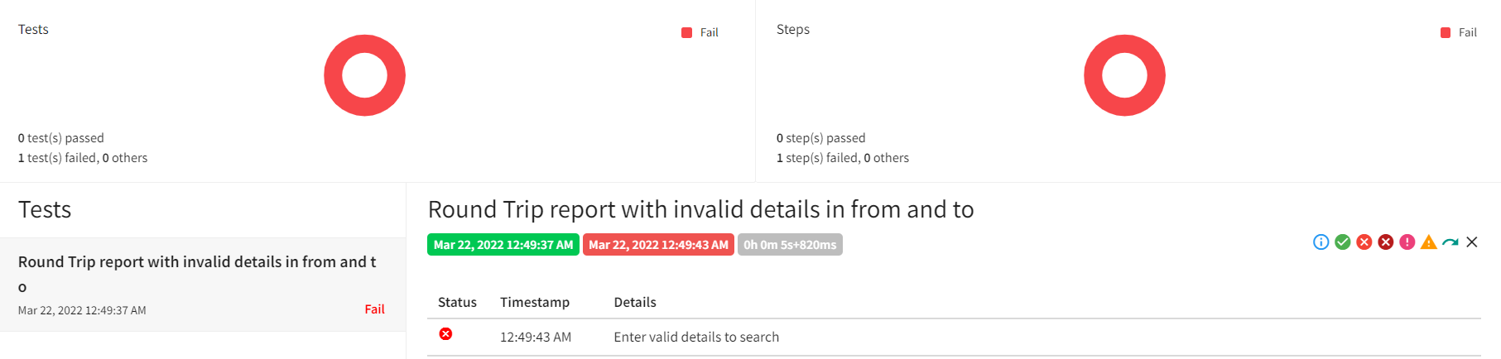
Report – Round Trip Flight Booking

Slide 31
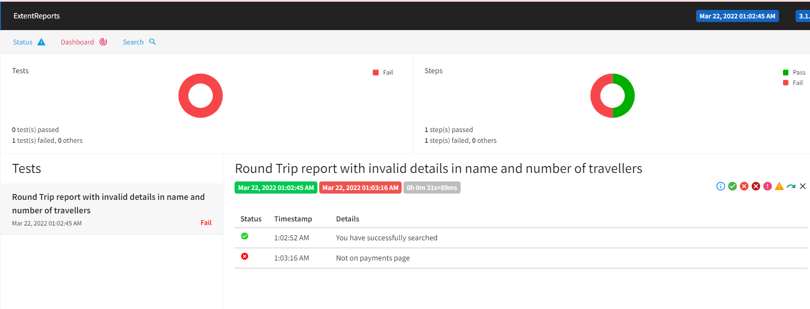
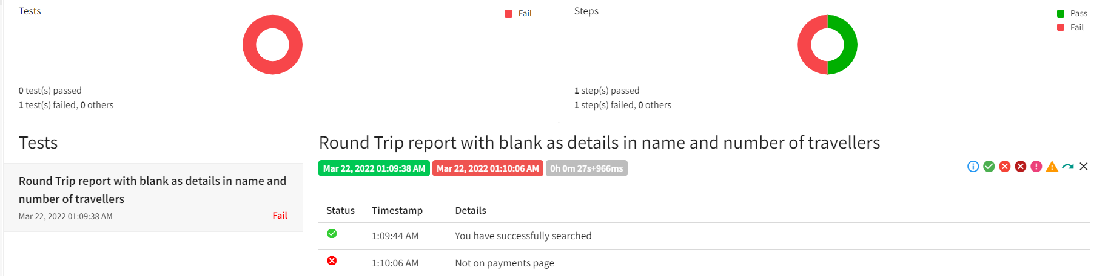
Report – Round Trip Flight Booking

Slide 32
Problems Faced
The following problems were faced during the testing phase of the application in automate testing while writing the test codes in Selenium:
During the flight search, the order of result of flight always vary. The change in order result the find not found exception as the xpath shows incorrect because the code written for the flight doesn’t appears in the search result.
When we redirect to payments page after selection of flight, Often the flight fares gets changed for the flight due to which the dialogue box appears, and program get stopped so the code needs to be changed to tackle the dialogue box and the new amount.
When some invalid inputs are given for the page, it will not redirect to the next page and when we try to search the element in next page it will show element not found exception. This creates the problem when we are generating reports to check display of next page.
When we give invalid inputs in from, to and destination tab, no suggestion box appears, and we have already given the actions to select the city from suggestion box, so the command needs to be removed during invalid search.
Writing the code for perfect report generation also posses us lots of problems and time investment.

Slide 33
Conclusion:
The website is completely tested against all positive and negative test cases for the following functions:
Login
Registration
Flight search and booking
Hotel search and bookings
The test cases are generated for all the functions and automation testing is completed with all the reports generation.
Result:
The Following VIA.com website is working completely fine for all the functions and all the test cases are successfully passed with positive test report generation.

Slide 34
WORK REPOSITORY
All our work and efforts can be found in this GitHub Repository Link:
https://github.com/Shikhar0542/GladiatorProject_Group6.git

